Slide 1
Emotional handling in Hindi TTS System
Project guide
Rohith HP

Slide 2
AGENDA
Introduction
Speech Syntheses
Problem Statement
Objective of the study
Issues
Emotions in Speech
Current Scope
Future Scope
Our Team

Slide 3

INTRODUCTION
A Text-To-Speech(TTS) system synthesizes a speech output for a given text input text.
A Text to Speech System is composed of two parts : a front-end and back end.
The techniques employed for synthesizing speech from text may be broadly classified in to three categories :
Formant-based.
Pre-recorded synthesis.
Concatenation-based.

Slide 4
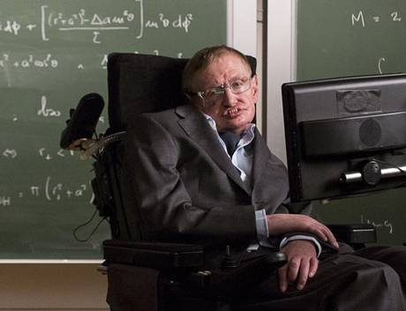
Stephen hawking
This world renowned theoretical physicist uses a text to speech synthesizer for communication. He types in the letters using his cheek. The machine is called the DECtalk DTC01 which is no longer in production.

Slide 5
What is speech synthesis ?
Automatic generation of waveforms.
Text to speech synthesis producer consists of two main phase:
  text analysis or high level synthesis: Input text is converted in to a phonetic or linguistic representation.
  generation of speech waveforms or low level .

Slide 6
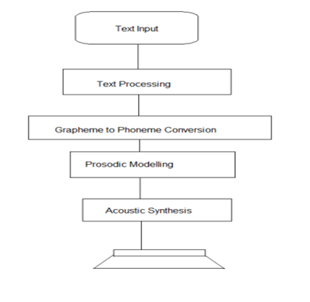
Block Diagram of speech Synthesizer

Slide 7
Statement of the Problem
Development of emotional handling in Hindi TTS system. The Hindi text is represented by a combination of syllables are concatenated to produce the phonetic representation of the speech being entered .

Slide 8
Objectives of the study
Understand the general concept of the text to speech system.
Understand the various available text to speech system with their characteristics, functionality and tradeoffs.
Handling emotions in text to speech engine for Hindi language.

Slide 9
Issues
Designing a keyboard for Hindi
Expansion of numbers in Hindi, complexity of double digits.
Reading two characters at the same time from the input file.
Using of equalizer software to modulate the wave files

Slide 10
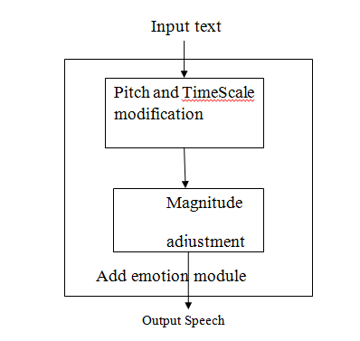
Emotions in Speech

Slide 11
Parameters Associated with Emotion
Frequency.
Loudness.
Duration.
Articulation.
Voice Quality.

Slide 12
Intensity.
Voice irregularity.
The ratio of high to low frequency energy.
Breathiness.

Slide 13
Speech Parameters and Emotions
 | Anger | Happiness | Sadness | Fear | Disgust
Speech rate | Slightly faster | Faster or slower | Slightly slower | Much faster | Very much slower
Pitch Average | Very much higher | Much higher | Slightly lower | Very much higher | Very much lower
Pitch range | Much wider | Much wider | Slightly narrower | Much wider | Slightly wider
Intensity | Higher | Higher | Lower | Normal | Lower
Voice quality | Breathy, chest tone | Breathy, blaring | Resonant | Irregular voicing | Grumbled, chest tone
Pitch changes | Abrupt, on stressed syllables | Smooth, upward inflections | Downward inflections | Normal | Wide, downward terminal inflections
Articulation | Tense | Normal | Slurring | Precise | Normal

Slide 14
Current Scope
Understand the practical design and implementation issues of current text to speech systems for the language Hindi.
Develop a prototype of emotion enabled text to speech engine for Hindi language and compare the basic algorithm with existing systems by considering several factors.

Slide 15
  Future Scope
Working towards a more natural speech synthesis in a TTS system.

Slide 16
Our team
ROHITH HP , Lecturer.
Nitte Meenakshi Institute of Technology.
Rakshith Shetty,8th sem,ISE.
Rohit Chakraborty,8th sem,ISE.
Rahul Kumar,8th sem,ISE.
Kapil Baghel,8th sem,ISE.

Slide 17
Thank You

